Slide 1
LIGHTING
For Portraits

Slide 2
Watch video (8:09):
https://www.youtube.com/watch?v=D_O6pbT7Ovw

Slide 3
In your Handbook…
Include the following light source terms:
(What is it? Where is it? What is its purpose?)
KEY LIGHT
FILL LIGHT
CATCH LIGHT
BACKGROUND LIGHT
BACKLIGHT / HAIR LIGHT
Include the following lighting techniques:
Include example images from the internet.
SPLIT LIGHTING
REMBRANDT LIGHTING
BUTTERFLY LIGHTING

Slide 4
KEY LIGHT
The main light that illuminates the subject being photographed.
The purpose of the key light is to shape the subject by highlighting the form and dimension of the subject.
The key light should be a high-intensity light.

Slide 5
In most cases, the key light is placed above and to the side of the face.
You will want to position the main light close to your subject without it appearing in the frame.
Note: You can emphasize texture and shape by skimming the light across the subject from the side.

Slide 6
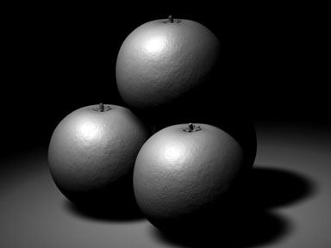
Key light coming from over here
Shadows are on opposite side from key light

Slide 7
FILL LIGHT
A light used to eliminate or soften shadows caused by the main source of illumination (from the key light).
The fill light controls the lightness or darkness of the shadows created by the key light. Because it does not create visible shadows, the fill light is defined as a secondary light source. The fill light should always be diffused.

Slide 8
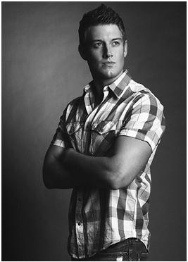
Key light coming from this side of subject
Fill light coming from this side of subject.
Notice that details within the shadow area are visible.
If there was no fill light, this side of the subject would look black!
http://pages.uoregon.edu/sankaran/252/project3/Project%203/filllighting.JPG

Slide 9
The next slide will show you examples of what some reflectors look like.
Reflectors usually come in:
White
Silver
Gold
Translucent
Black
Each reflector has a slightly different purpose or effect.

Slide 10
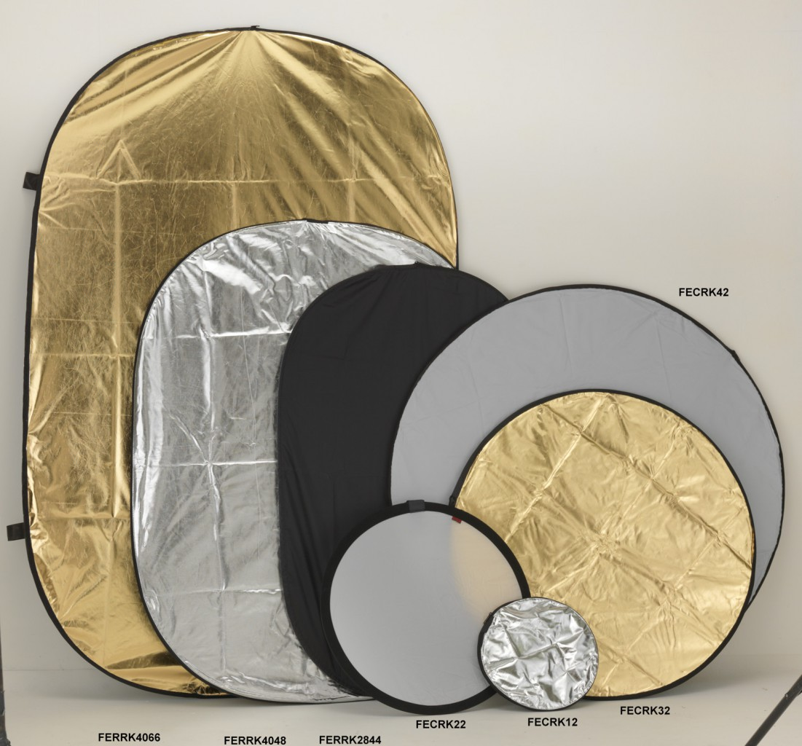
Gold: casts a warm glow on the subject. Great for outdoor portraits because it matches the warm color tones of sunlight.
Silver: reflects the most amount of light. Does not change colour tones, so it’s perfect for both indoor and outdoor portraits.
Black: the “anti-reflector.” Absorbs light. Cuts down on reflections from shiny, reflective surfaces Can be used to create shadows.
White: soft, clean light, and does not change colour tones. Good for indoor and outdoor. Needs to be close to subject. Not good for low-light situations – won’t reflect enough light.
Translucent (partly see-transparent): diffuses light – makes it softer. Does not reflect light. Place between light source and subject.

Slide 11
CATCH LIGHT
Catch lights are small specular highlights in the iris (your subject’s eye).
They key light should create a catch light on your subject’s eyes. This makes his/her eyes sparkle! (It also makes your subject look alive.)
The shape of the catch light depends on the shape of the light source that is being reflected off the subject’s eye.

Slide 12
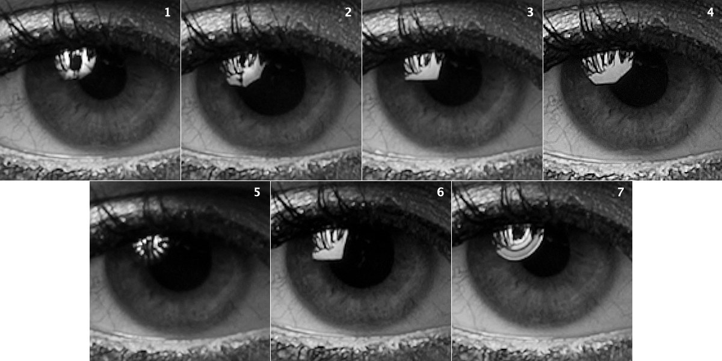
http://thelightingacademy.com/blog/wp-content/uploads/2012/04/catch_light_comp.jpg

Slide 13
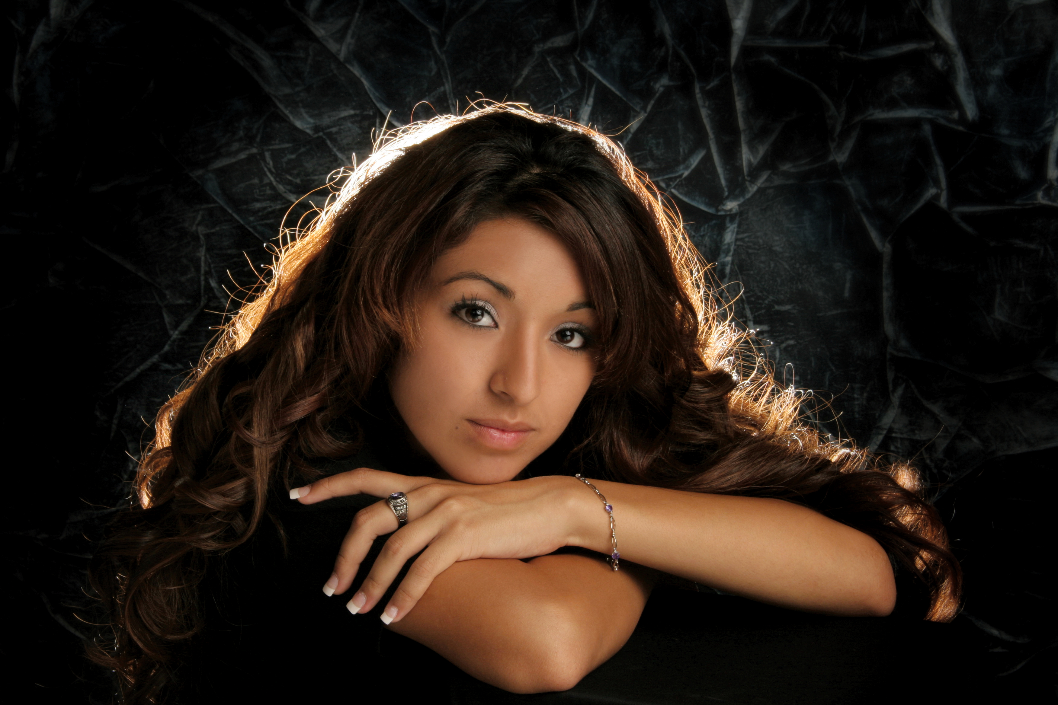
BACKGROUND LIGHT
It lights background elements (such as a backdrop, scenery, etc.).

Slide 14
BACKLIGHTING
Backlighting is the process of lighting the subject from the back. In other words, the backlight and the camera face each other, with the subject in between.
This creates a glowing effect on the edges of the subject, while other areas are darker.
The backlight can be a natural or artificial source of light.

Slide 15
Background light
Backlight /
hair light

Slide 16
The back light is sometimes called hair or shoulder light, because when lighting human subject, it makes the edges the subject's hair glow if the hair is fuzzy.
This can create an angelic halo-type effect around the head. Sometimes this effect it used to show that the subject is good or pure.
Backlighting helps separate subject and background.
It also helps to emphasize depth.

Slide 17
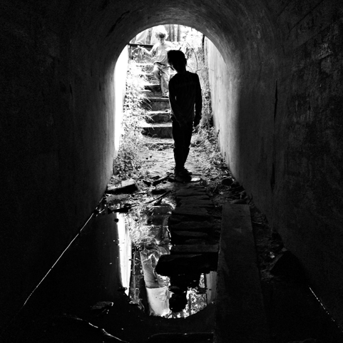
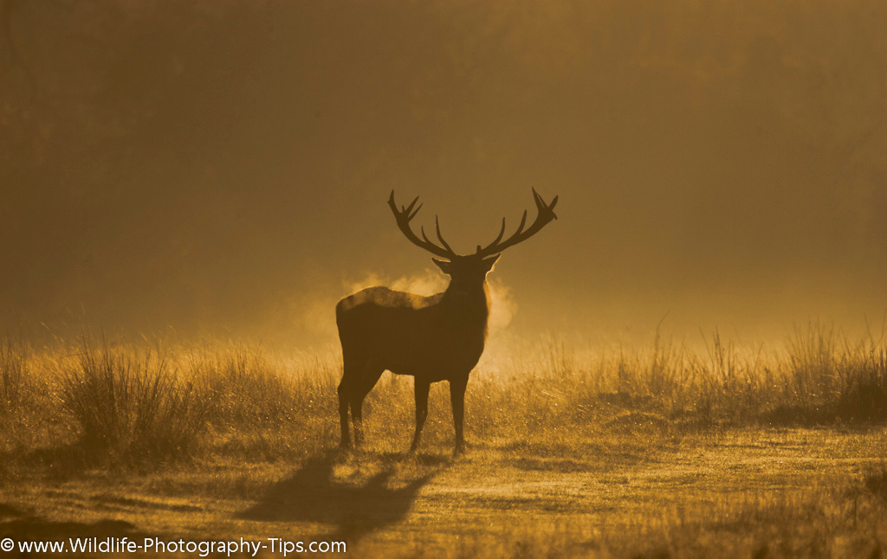
The sun is a great backlight When it is brighter than the key light, it will create a silhouette.

Slide 18
Remember:
All lights, no matter where they are or how big, create shadows.

Slide 19
LIGHTING TECHNIQUES
Split
Rembrandt
Butterfly

Slide 20
SPLIT LIGHTING
Splits the face exactly into equal halves with one side being in the light, and the other in shadow.
It is often used to create dramatic images for things such as a portrait of a musician or an artist.
To achieve split lighting simply put the light source 90 degrees to the left or right of the subject.
Watch how the light falls on them and adjust accordingly.

Slide 21
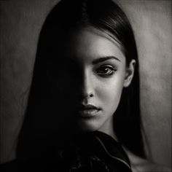
subject
Light source
This side is in shadows
This side is illuminated
camera

Slide 22
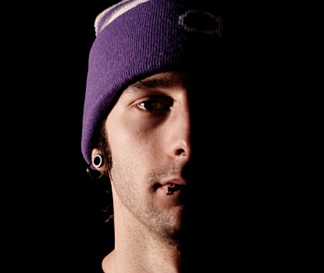
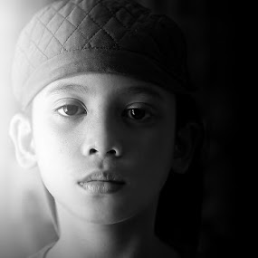

Slide 23
REMBRANDT LIGHTING
Can be achieved using one light and a reflector, or two lights.
Capable of producing images which appear both natural and compelling with a minimum of equipment.
Is characterized by an illuminated triangle under the eye of the subject on the less illuminated side of the face.
It is named for the Dutch painter Rembrandt, who often used this type of lighting.

Slide 24
The key light is placed high and to one side at the front, and the fill light or a reflector is placed half-height and on the other side at the front.
The key in Rembrandt lighting is creating the triangle or diamond shape of light underneath the eye.

Slide 25
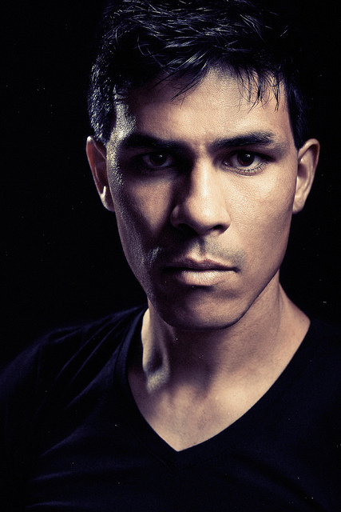
Triangle of light under the eye
Key light
Fill light

Slide 26
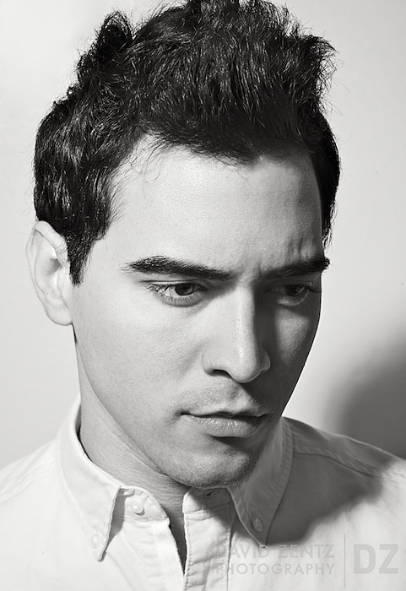
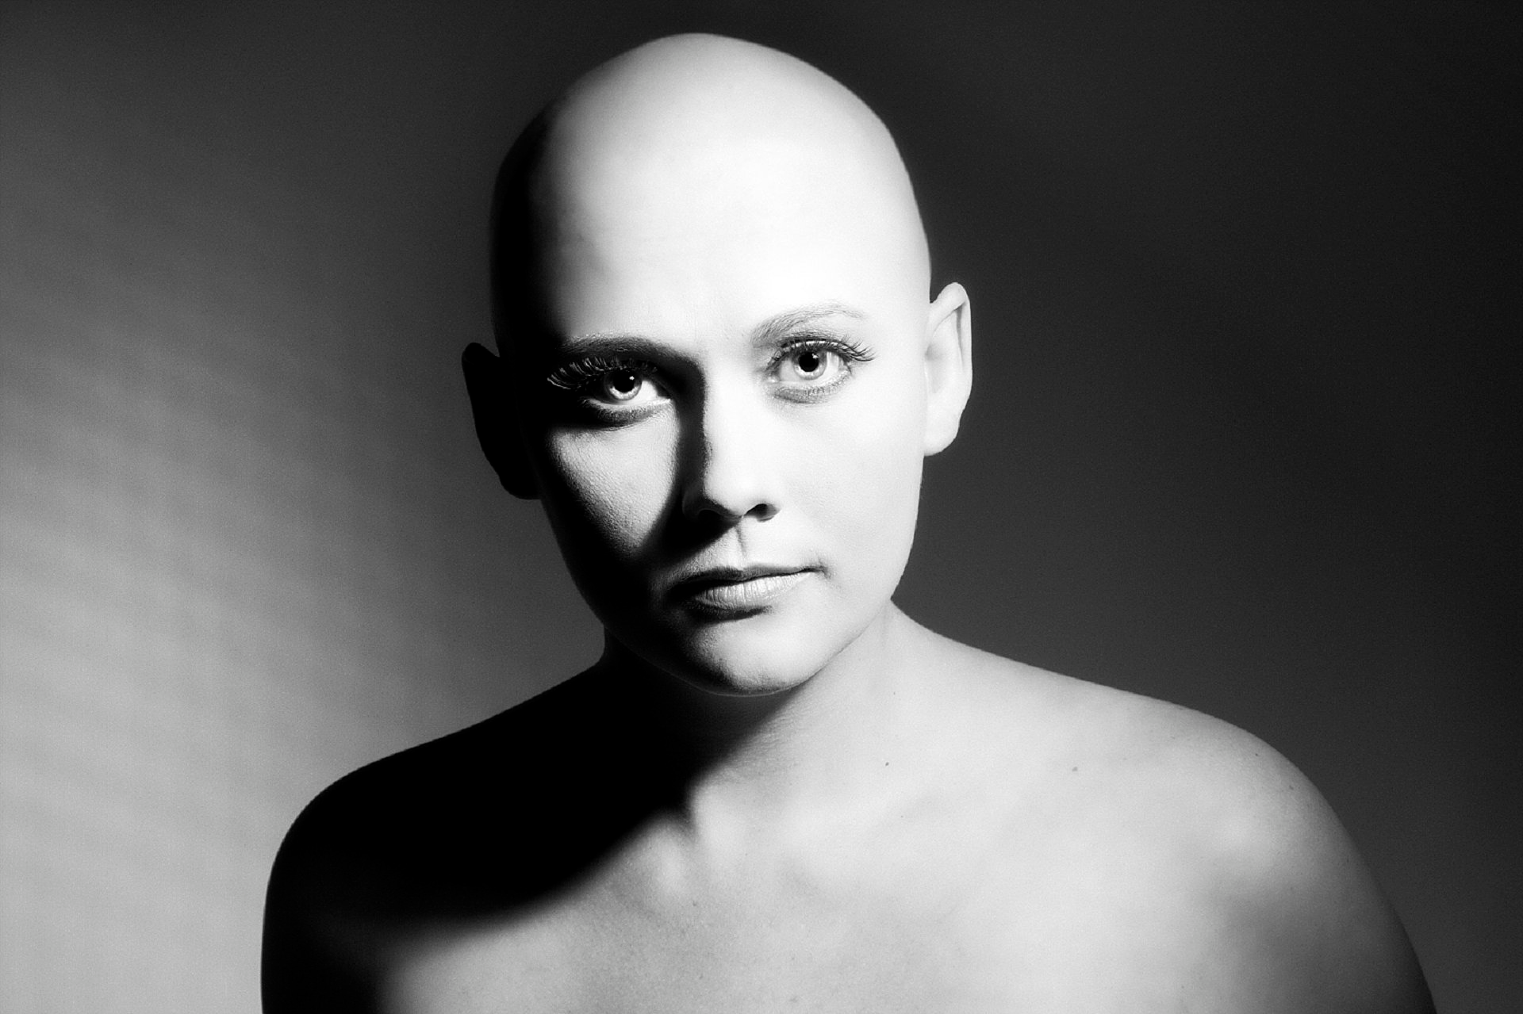
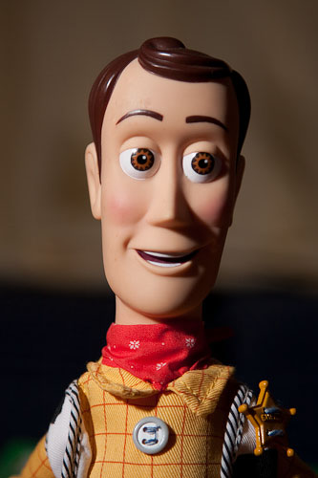

Slide 27
BUTTERFLY LIGHTING
Named for the butterfly shaped shadow that is created under the nose by placing the main light source above and directly behind the camera.
The photographer is basically shooting underneath the light source.
It is most often used for glamour style shots and to create shadows under the cheeks and chin. It is also flattering for older subjects as it emphasizes wrinkles less than side lighting.

Slide 28
