Slide 1
Introduction Digital Photography

Slide 2
Create your own handbook
Using PowerPoint or Word create a Digital Design Handbook.
Slide 1 is your title slide:
(YOUR NAME) Digital Photography Handbook

Slide 3
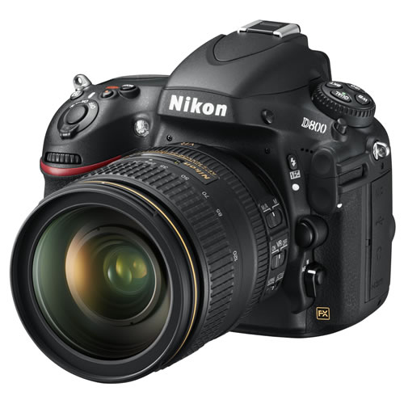
DSLR
Stands for digital single-lens reflex
With an SLR camera, you see exactly what the lens sees
You can change the lens on a digital SLR
Digital SLRs have large image sensors that produce high-quality photos
An SLR has a near-zero lag time, and is ideal for action photography
You can take photos of everything from sleeping kittens to race cars and you'll never be limited by your camera.

Slide 4
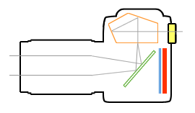
Mechanics of a DSLR camera
Light passes through the lens and strikes a mirror (green)
The mirror reflects the light up to a focusing screen
Light passes through the focusing screen and enters a block of glass called a pentaprism (orange)
The pentaprism reflects the image so that you can see it in the viewfinder
When you take a photo, the mirror flips up and a shutter (blue) opens that exposes the digital sensor (red) to light

Slide 5
Memory Card
When you take a picture on a digital camera, it is recorded onto a flash memory storage card. Flash memory offers fast read/write times and are very reliable being able to withstand extreme conditions.

Slide 6
Grab your cameras!

Slide 7
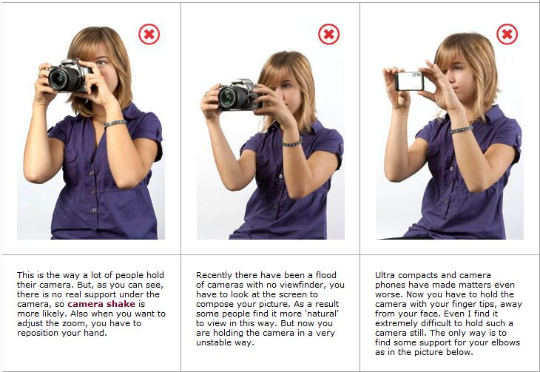
Holding the Camera Incorrect

Slide 8
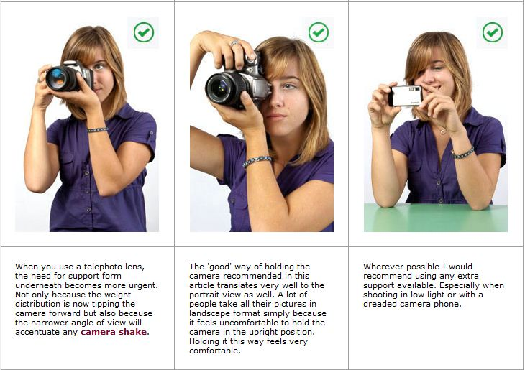
Holding the Camera Properly

Slide 9
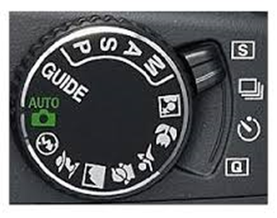
The Camera
Before using the camera find the following:
Battery – MAKE SURE CAMERA IS TURNED OFF BEFORE YOU REMOVE THE BATTERY
Memory Card
USB Connector
Mode Dial – make sure it’s on AUTO
green flash on if required
lightning bolt – flash off
Release Mode Selector
- make sure it’s on S (single frame)
- continuous (records several pictures)
- Self-timer (takes a picture after 10 seconds)
- Quiet shutter release (camera makes less noise after shooting)

Slide 10
The Power Switch – ON/OFF
Information Button
AF button – Automatic Focus (leave it on AF for now)
MF button – Manual Focus
Menu
Image Quality (set to JPEG normal)
Image Size (Medium)
Viewfinder
Playback Button
LCD Monitor

Slide 11
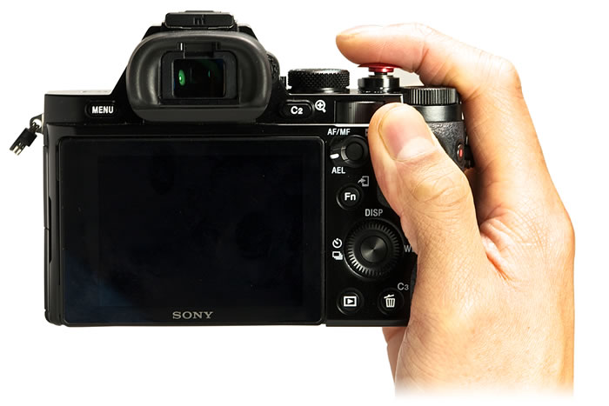
Shutter Release Button
Press halfway
WHY?

