Slide 1
Lighting for Texture

Slide 2
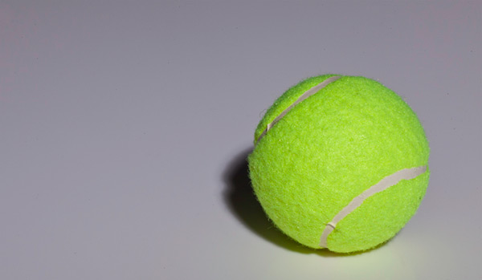
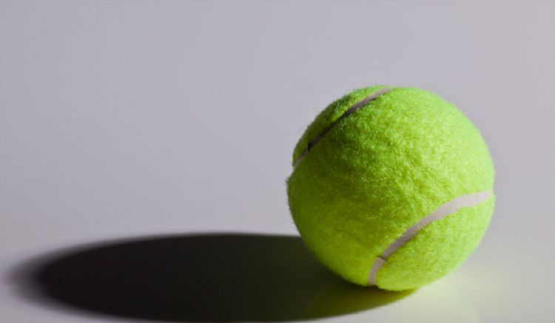
Light source?
Minimum or maximum texture?
Light source?
Minimum or maximum texture?

