Slide 1
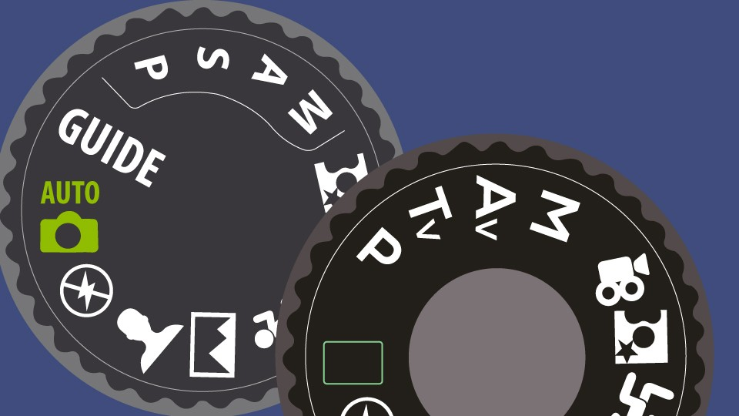
Automatic Exposure Modes

Slide 2
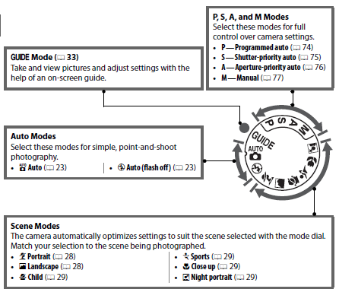
Scene Modes
The following scenes can be selected with the mode dial:
Portrait
Landscape
Child
Sports
Close up (aka macro)
Night Portrait

Slide 3
Here is a brief description of each:

Slide 4
The next few slides are some examples of when you’d use these settings.
It is important to try not to take the titles of each mode too literally: for instance, it doesn’t have to be a “sport” to use sport mode.

Slide 5
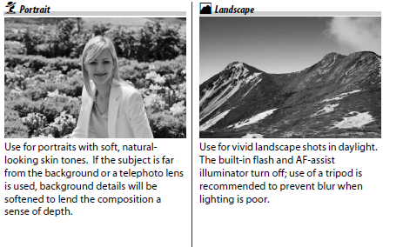
Portrait and Landscape

Slide 6
Landscape

Slide 7
Child and Close Up (aka Macro)

Slide 8
Macro (aka close-up)

Slide 9
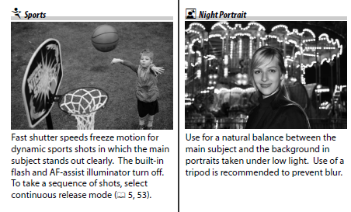
Sports and Night Portrait

Slide 10
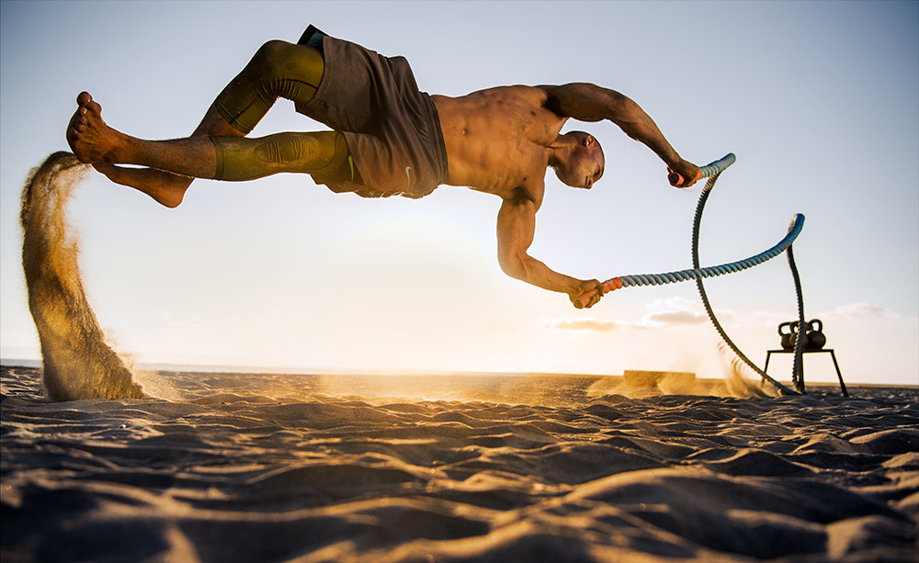
Sport
Sport

Slide 11
Night

